Slide 1
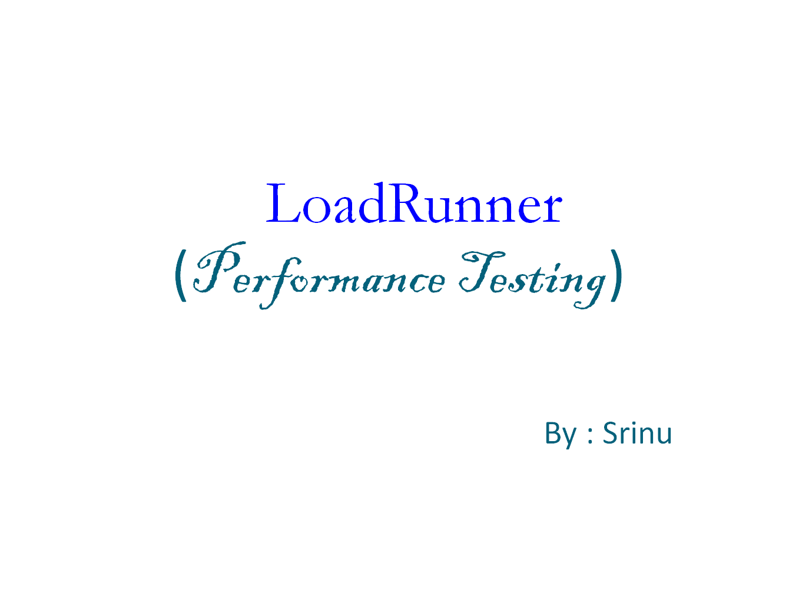

Slide 2
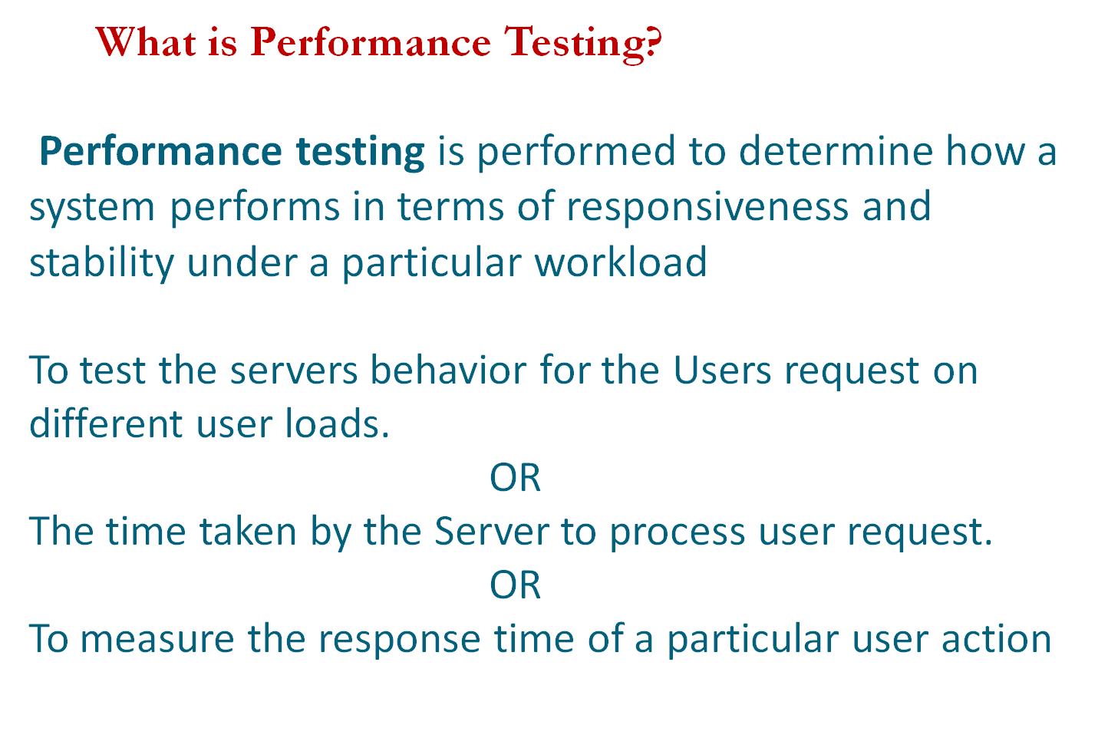

Slide 3
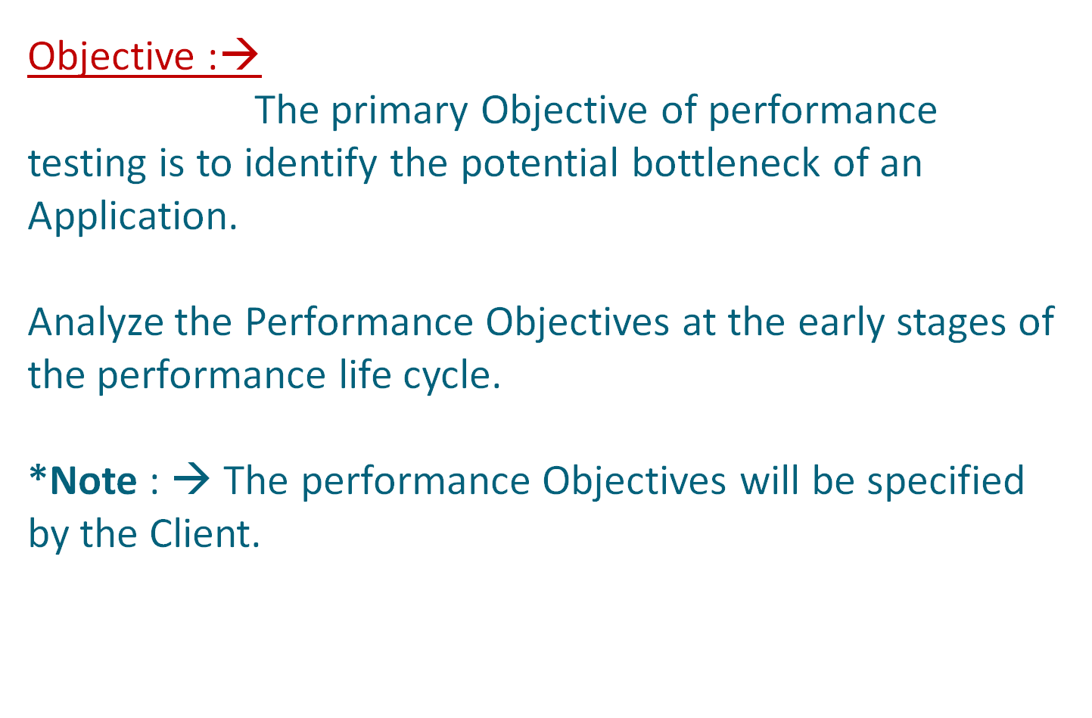

Slide 4
Performance Testing Process
Performance Test Requirements
Test Planning
Test Automation(Scripts)
Test Execution
Test Monitoring
Analysis & Reporting

Slide 5
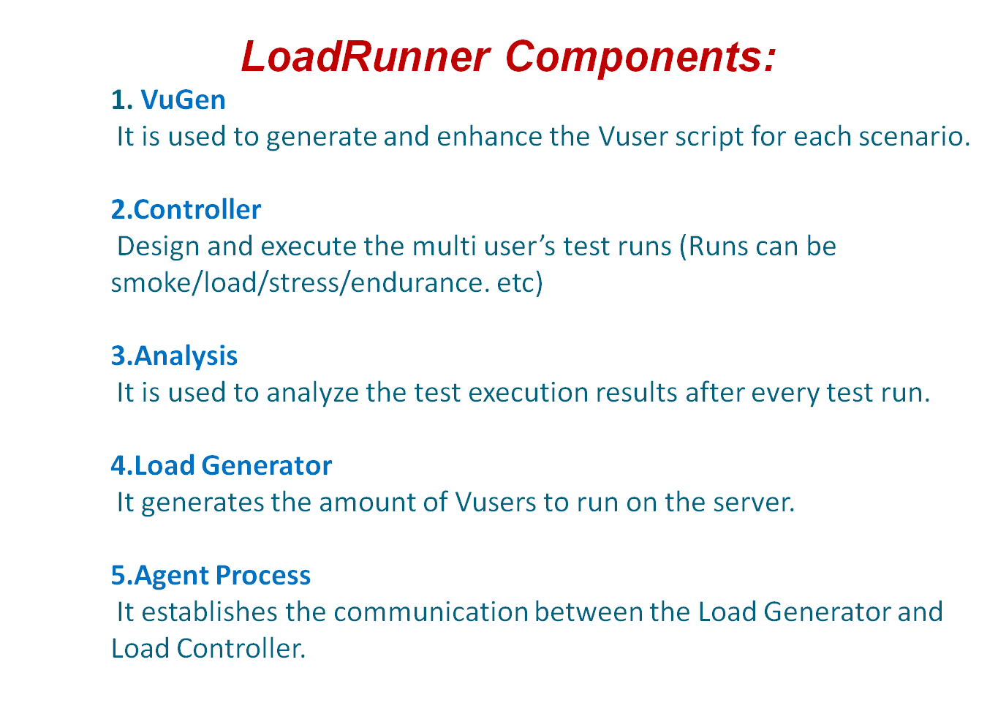

Slide 6
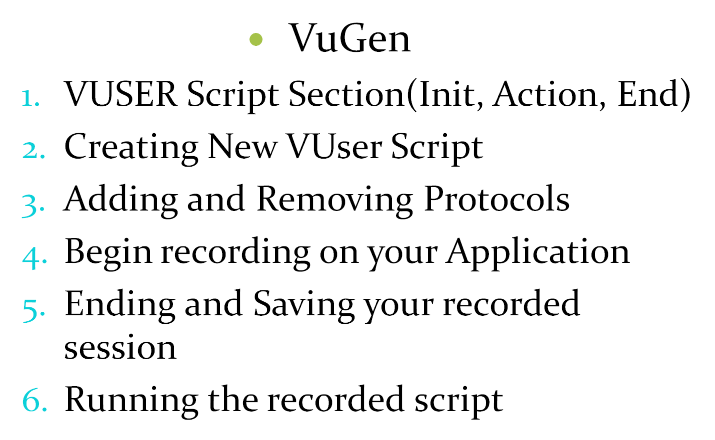
LoadRunner(9.5)

Slide 7
Introduction to Transactions
What are Transactions
Why we need Transactions
How to insert Transactions in the Script
Configuring Run Time Settings
Correlation
Manual Correlation
Automatic Correlation

Slide 8
Correlation
Manual Correlation
Automatic Correlation

Slide 9
Manual Correlation
Handle the server generated data by following the below steps without help of the automation features in the tool.
01 Identify the server generated value in script.
  Generate the two identical business scripts.
  Go to Tools menu and select ‘Compare with Script’ option.
  Open another script for the comparison.
  The two scripts comparison will display under WDiff utility.
  The differentiated values in the two scripts will be highlighted.
  Identify the correlated value from the comparison.

Slide 10
02. Capture the new set of data which is generated by the server.
Copy the identified correlated value
Go to Tree view and find out the copied value in server response of previous request.
Identify the left (LB) and right boundaries (RB) of the correlated value.
Identify the Ordinal value (ORD)
Insert the correlation function with all the arguments as below -
Web_reg_save_param(“ParameterName”, “LB=”, “RB=”, “ORD=”,LAST);

Slide 11
Automatic Correlation
It is the concept of handling the correlated data with the help of tool functionalities in the script.
There are two types of automatic correlation
Scan Scripts for Correlations
Using Correlation Rule

Slide 12
Scan Scripts for Correlations
Scan Scripts for Correlations:
1.Generate script with end to end user actions.
2.Run the script once and select ‘Scan Script for Correlations’ under Vuser menu option
  3. It shows the differentiate values between the recording and replay runs in Correlation Results.
  4. Select the value to be correlated and Click Correlate button in the Correlation Results.
  5.It will automatically insert the correlated function with all the arguments.

Slide 13
Using Correlation Rule
  Enable the correlation in recording options.
  Create the correlation rule with all the arguments – Left Boundary (LB), Right Boundary (RB) and ORD values.
// [WCSPARAM WCSParam_Diff1 44 106340.440259214ftzQiizpDQfiDDDDDciVQpDViDHf] Parameter {WCSParam_Diff1} created by Correlation Studio
web_reg_save_param( "WCSParam_Diff1", "LB=userSession value=", "RB=>", "Ord=1", LAST );
Generate the script with all end to end user actions.
It will automatically insert the correlation function with all the arguments during the script recording

Slide 14
Parameterization
To pass different set of user inputs for different users running in the execution then use Parameterization
Sequential – Each Iteration
It will update the new parameter value for each Iteration of the Script execution by sequentially
I1 I2 I3 I4 I5
User 1 jojo1 jojo2 jojo3 jojo4 jojo5
User 2 jojo1 jojo2 jojo3 jojo4 jojo5
User 3 jojo1 jojo2 jojo3 jojo4 jojo5
User 4 jojo1 jojo2 jojo3 jojo4 jojo5
User 5 jojo1 jojo2 jojo3 jojo4 jojo5

Slide 15
2. Sequential – Once
A single parameter value will be assigned for all the Iterations done by each Vuser
I1 I2 I3 I4 I5
User 1 jojo1 jojo1 jojo1 jojo1 jojo1
User 2 jojo1 jojo1 jojo1 jojo1 jojo1
User 3 jojo1 jojo1 jojo1 jojo1 jojo1
User 4 jojo1 jojo1 jojo1 jojo1 jojo1
User 5 jojo1 jojo1 jojo1 jojo1 jojo1

Slide 16
Random -- Each Iteration
Random – Each Iteration
The new random parameter value will be updated for each Iteration of the Script execution
I1 I2 I3 I4 I5
User 1 jojo1 jojo5 jojo6 jojo8 jojo3
User 2 jojo2 jojo3 jojo3 jojo5 jojo4
User 3 jojo8 jojo4 jojo9 jojo10 jojo25
User 4 jojo8 jojo15 jojo12 jojo21 jojo24
User 5 jojo18 jojo20 jojo1 jojo5 jojo7

Slide 17
Random -- Once
Random – Once
Single random parameter value will be assigned for all the Iterations done by each Vuser
I1 I2 I3 I4 I5
User 1 jojo10 jojo10 jojo10 jojo10 jojo10
User 2 jojo4 jojo4 jojo4 jojo4 jojo4
User 3 jojo8 jojo8 jojo8 jojo8 jojo8
User 4 jojo11 jojo11 jojo11 jojo11 jojo11
User 5 jojo19 jojo19 jojo19 jojo19 jojo19

Slide 18
Unique – Each Iteration
The Unique parameter value will be updated for each Iteration of the script execution
I1 I2 I3 I4 I5
User 1 jojo1 jojo2 jojo3 jojo4 jojo5
User 2 jojo6 jojo7 jojo8 jojo9 jojo10
User 3 jojo11 jojo12 jojo13 jojo14 jojo15
User 4 jojo16 jojo17 jojo18 jojo19 jojo20
User 5 jojo21 jojo22 jojo23 jojo24 jojo25

Slide 19
Unique -- Once
Unique – Once
A single unique parameter value will be assigned for al the Iterations done my each Vuser
I1 I2 I3 I4 I5
User 1 jojo1jojo2 jojo3 jojo4 jojo5
User 2 jojo6 jojo7 jojo8 jojo9 jojo10
User 3 jojo11 jojo12 jojo13 jojo14 jojo15
User 4 jojo16 jojo17 jojo18 jojo19 jojo20
User 5 jojo21 jojo22 jojo23 jojo24 jojo25

Slide 20
Randomized Functions:
To select a random value from the available array list, use the below types of random functions whenever ORD=all.
lr_paramarr_random() :
It selects one random value from the available array range.
lr_paramarr_idx() :
It selects the specific index from the list of array values.
lr_paramarr_len() :
It calculates the length of the given parameter array.

